Slide 1


Hate Speech
Detection In Tweets
Prepared By:
Aaditya Rathod
IIT2020209
NLP Course Project

Slide 2

Table Of Contents
1) Introduction
2) What is hate speech?
3) Problem Statement and Objective
4) Base Papers
5) Methodology
6) Dataset Description
7) Preprocessing
8) Feature Extraction
9) Machine Learning Models
10) Results

Slide 3

Introduction
After the advent of social media and its increasing number of users, there is less and less control over the content posted by them. Hate and abusive speech being one of these.
People are now able to express or show any type of emotion online which was once difficult when talking to a person face to face.
We can see hate content being posted daily in the form of comments, images, videos etc.
Automated hate speech detection plays a huge role when dealing with a huge number of users. Here we will be using machine learning classification models to classify hate comments and tweets.

Slide 4
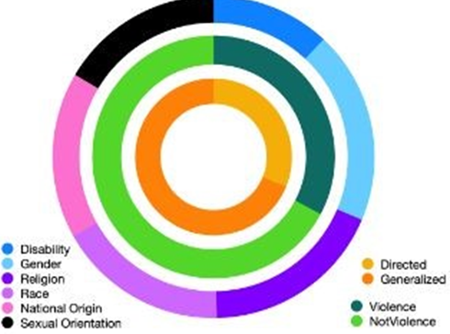
WHAT IS HATE SPEECH V/S OFFENSIVE SPEECH
Online hate is composed of the use of language that contains either hate speech targeted toward individuals or groups, profanity, offensive language, or toxicity whereas offensive language contains offensive terms but is not targeting any group in particular.

Slide 5


Problem Statement
and Objective
● Hate Speech recognition is to identify hate comments/posts on various social media platforms so appropriate measures can be taken to improve interactions on these platforms.
● The objective of this presentation is to classify the data as hate speech, offensive speech and neither using various machine learning models used for classification.
● From all the research papers that we have gone through, we have selected 2 papers as our base research papers to know more about the machine learning models and the datasets.
● As a consequence of knowledge that we have gained through the study of papers we have prepared the results.

Slide 6
Base Paper
Profiling Hate Speech Spreaders on Twitter
Reference Link -
https://www.researchgate.net/publication/354185105_Profiling_Hate_Speech_Spreaders_on_Twitter

Slide 7


Obtainings from base paper
Use of classification reports and confusion matrix, these metrics are widely used for evaluating supervised machine learning models for classification when the dataset is multi-labelled.
Calculating Precision, recall and F1 score and combining them to find the best model

Slide 8
Conclusions obtained from base paper
The prediction of whether a user is spreading hate speech or not from his combined tweets is a challenging task as tweets have various noise in terms of grammatical mistakes, spelling mistakes, and non-standard abbreviations.
Comparative study of machine learning algorithms with respective feature sets.
Accuracy estimation in each case in the result section.
This system can also be utilized by different social media platforms to identify hate speech spreaders and remove such hate speech spreaders from their platform.

Slide 9
Methodology
The first step was to choose the dataset to test our model.
Next we have done preprocessing using stop words, stemming, tokenization etc.
01
02
Before testing our model on the dataset, feature extraction was done to get numerical data using TF-IDF vectorization.
Next we finally test our data on 3 models Random Forest, Naive Bayes, and XGBoost then calculated accuracy, F1 Score, recall, precision.
03
04

Slide 10
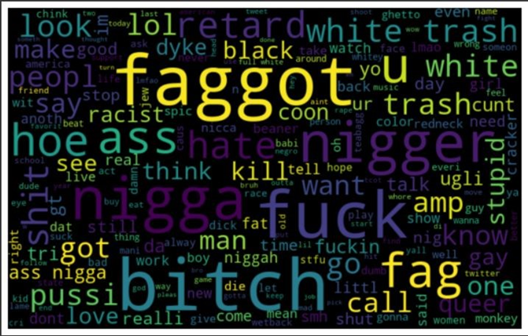
Dataset Description
Dataset: Davidson et al.[7]
Davidson et al. (2017) collected tweets containing terms from the Hatebase,2 a crowdsourced hate speech lexicon, then had a sample coded by crowdworkers located in the United States. To avoid false positives that occurred in prior work which considered all uses of particular terms as hate speech, crowdworkers were instructed not to make their decisions based upon any words or phrases in particular, no matter how offensive, but on the overall tweet and the inferred context. The dataset consists of 24,783 tweets annotated as hate speech, offensive language, or neither.

Slide 11
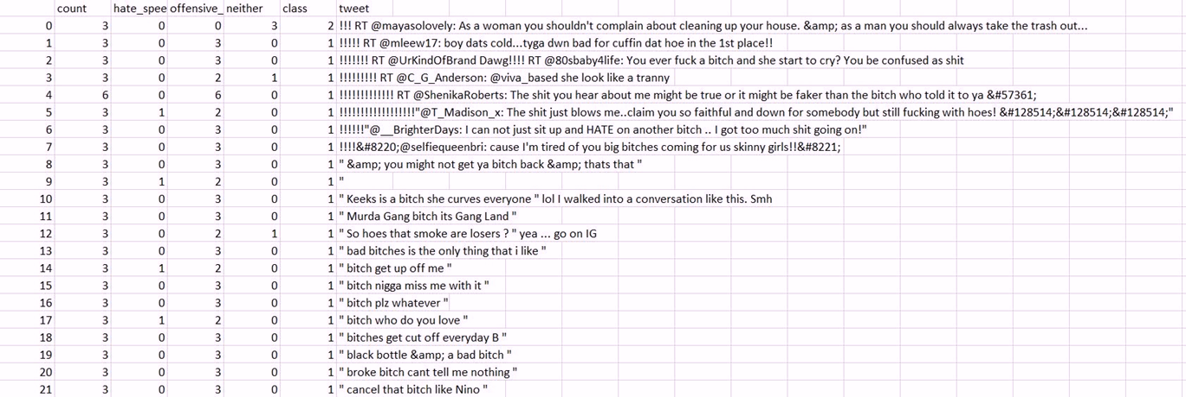

Slide 12
Table 1: Class wise distribution of dataset
Table 2: Words with Highest Frequency in Dataset
Class | No. of Instances
0 | 1430
1 | 19190
2 | 4163
Total | 24783
bitch | faggot
fuck | call
nigga | love
pussi | fuckin
shit | hoe

Slide 13
Data Preprocessing
A. Tokenizing
B. Stop Words
C. Stemming
D. Case Folding
Tokenizing is process in which each sentence is divided into words. This is used to create a vocabulary for our dataset. This vocabulary is used to represent each tweet in our dataset.
Stop words are those words which has less meaning or are useless for example a, the, of which often occurs in most sentences. So it is required to remove this stop words otherwise it will cause misclassification.
Stemming is process in which the prefix or suffix of a word is removed to make similar in common form.For e.g processing, process and processed have basically same meaning if we ignore the tense so it is required to convert all this word in similar form.
In case folding all word are changed in lowercase. This is used to make the vocabulary as small as possible.

Slide 14
Feature Extraction
The mapping from textual data to real valued vectors is called feature extraction.
Feature extraction is nothing but numerical representation of text so that it can be easily processed by machine learning models.

Slide 15
Tf-IDf Vectorizer
Term Frequency-Inverse Document Frequency(TF-IDF): It is a statistical measure that evaluates how relevant a word is to a document in a collection of documents.
Term Frequency:
(Number of times term t appears in the tweet)/(number of terms in the tweet).
Inverse Document Frequency:
log(N/n) where N is the number of tweets and n is the number of tweets a term t has appeared in IDF value of rare word is high and frequent word is low.
TF-IDF value of a term = TF x IDF Therefore Steps you need to follow :
1) Create a term frequency matrix where rows are tweets and columns are distinct terms throughout all tweets.
2) Compute inverse document frequency (IDF) using the previously explained formula.
3) Multiply TF matrix with IDF respectively
4) Now the data could be used by the machine learning models.

Slide 16

Machine learning models

Slide 17
Random Forest
Random Forest works in two-phase first is to create the random forest by combining N decision tree, and second is to make predictions for each tree created in the first phase.Select random K data points from the training set. Build the decision trees associated with the selected data points (Subsets).Choose the number N for decision trees that you want to build.Repeat Step 1 & 2.

Slide 18
Naïve Bayes
A Naive Bayes classifier is a probabilistic machine learning model that’s used for classification task. The crux of the classifier is based on the Bayes theorem. Using Bayes theorem, we can find the probability of A happening, given that B has occurred. Here, B is the evidence and A is the hypothesis. The assumption made here is that the predictors/features are independent. That is presence of one particular feature does not affect the other. Hence it is called naive.
P(A|B) = P(B|A) * P(A) / P(B)
XG Boost
XG Boost is an optimized distributed gradient boosting library designed for efficient and scalable training of machine learning models. It is an ensemble learning method that combines the predictions of multiple weak models to produce a stronger prediction. In this algorithm, decision trees are created in sequential form. Weights play an important role in XG Boost.

Slide 19
Results
3 Categories (Hate Speech, Offensive Language, Neither):
XGBoost: 96%
Random Forest: 97%
Naive Bayes: 86%

Slide 20


Thank You

